Slide 1


Intro Android
Speaker:
Andrii Rudyk

Slide 2
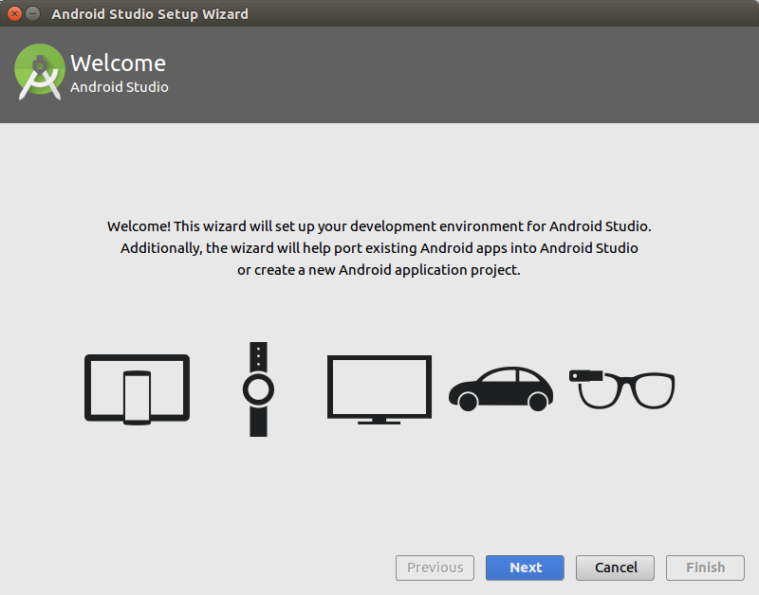
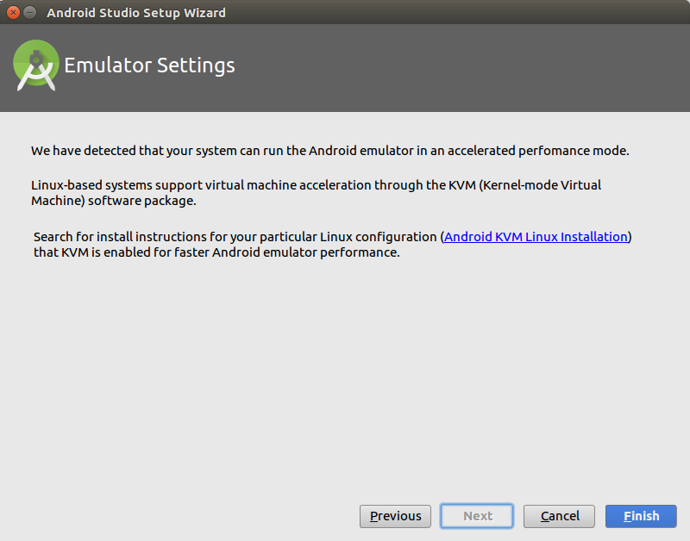
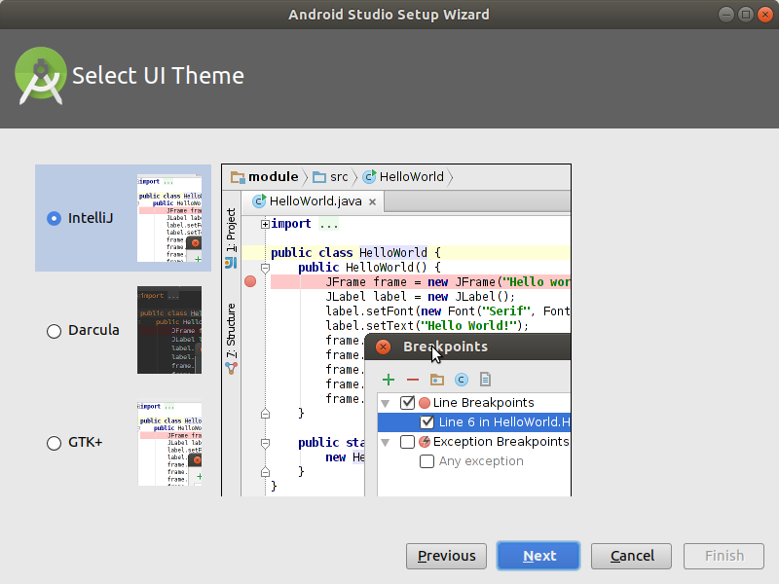
Android Studio - Installation

Slide 3
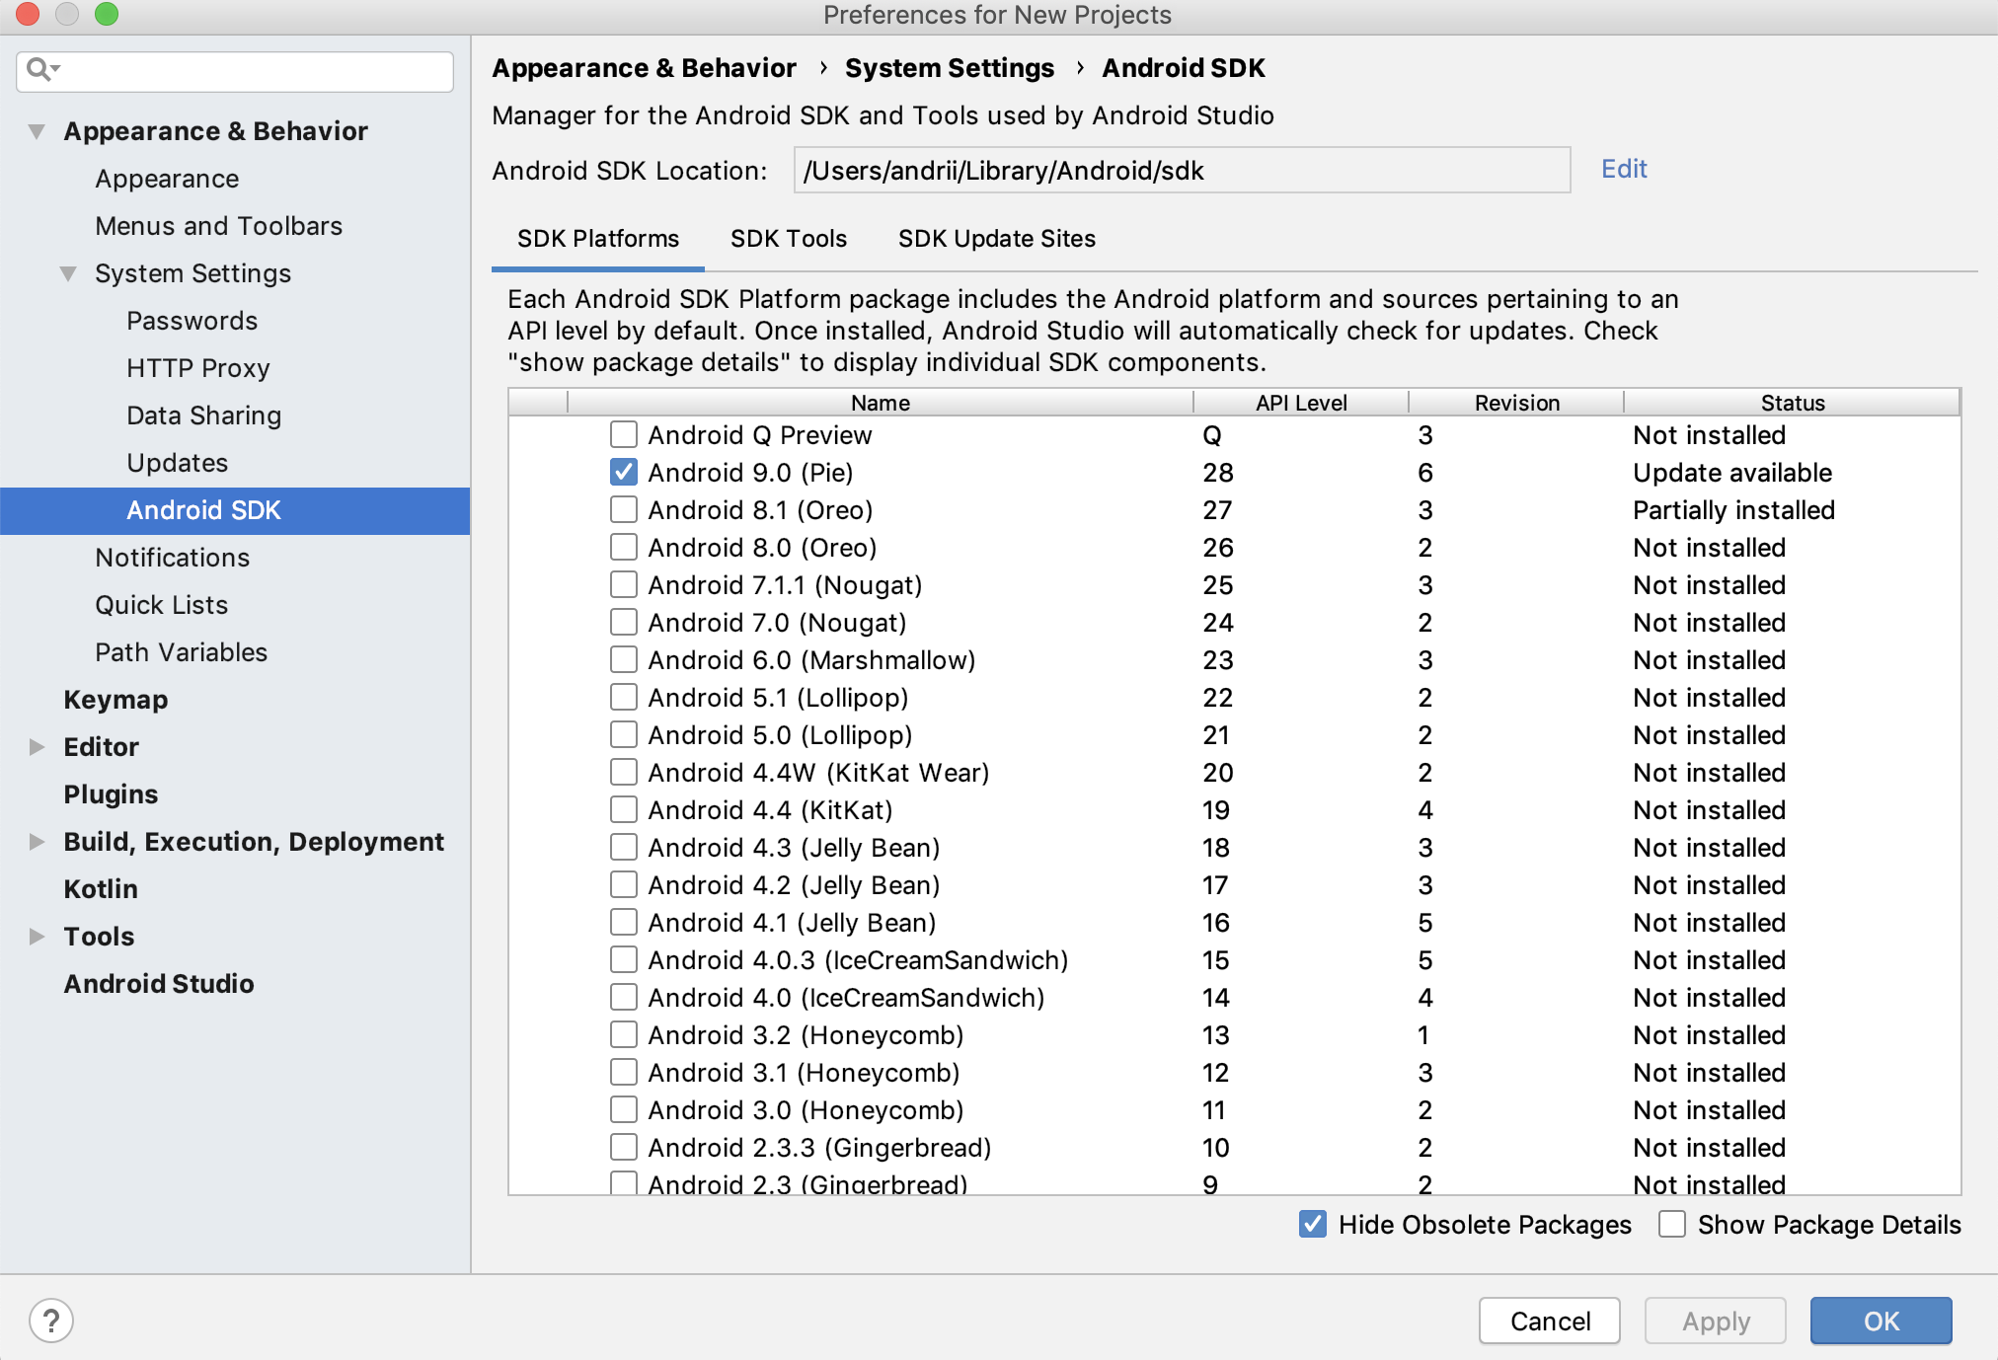
Android Studio - Installation of Android SDKs

Slide 4
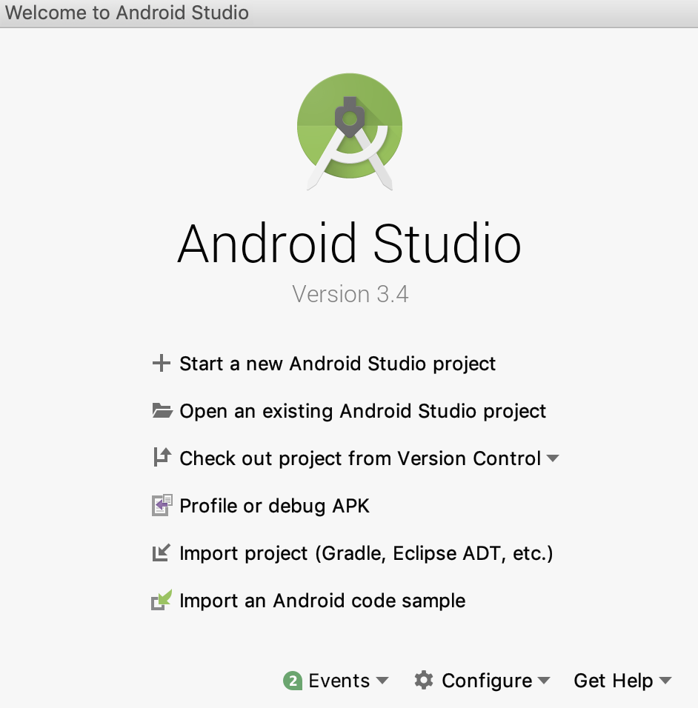
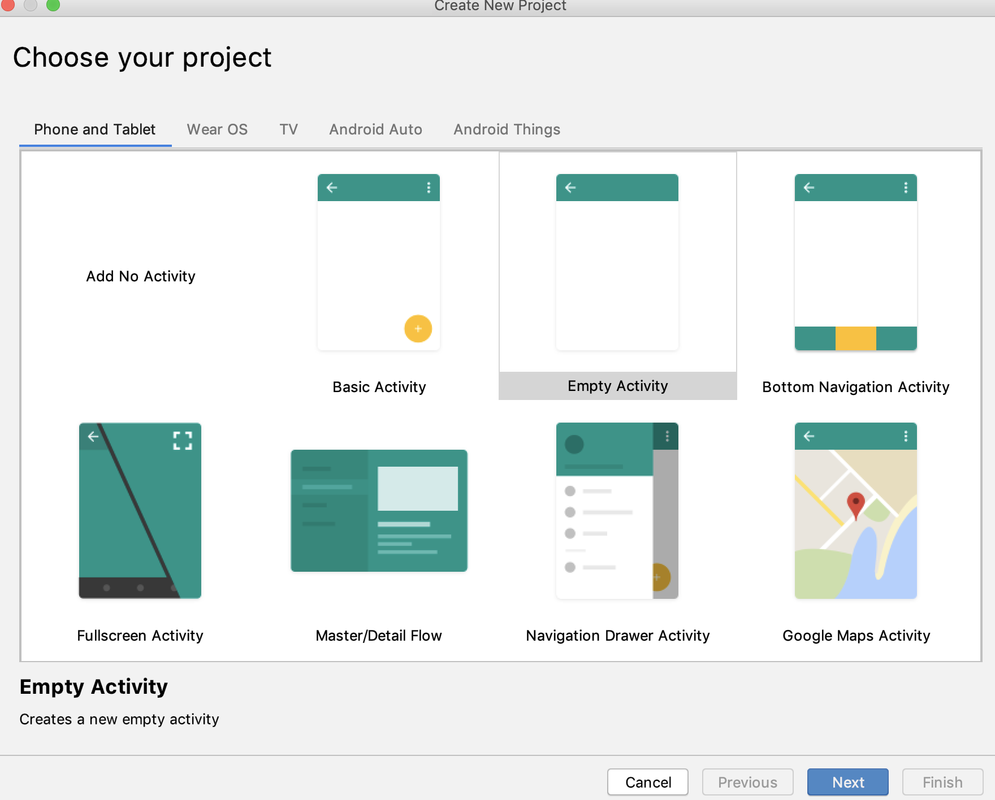
Android Application - Hello World

Slide 5
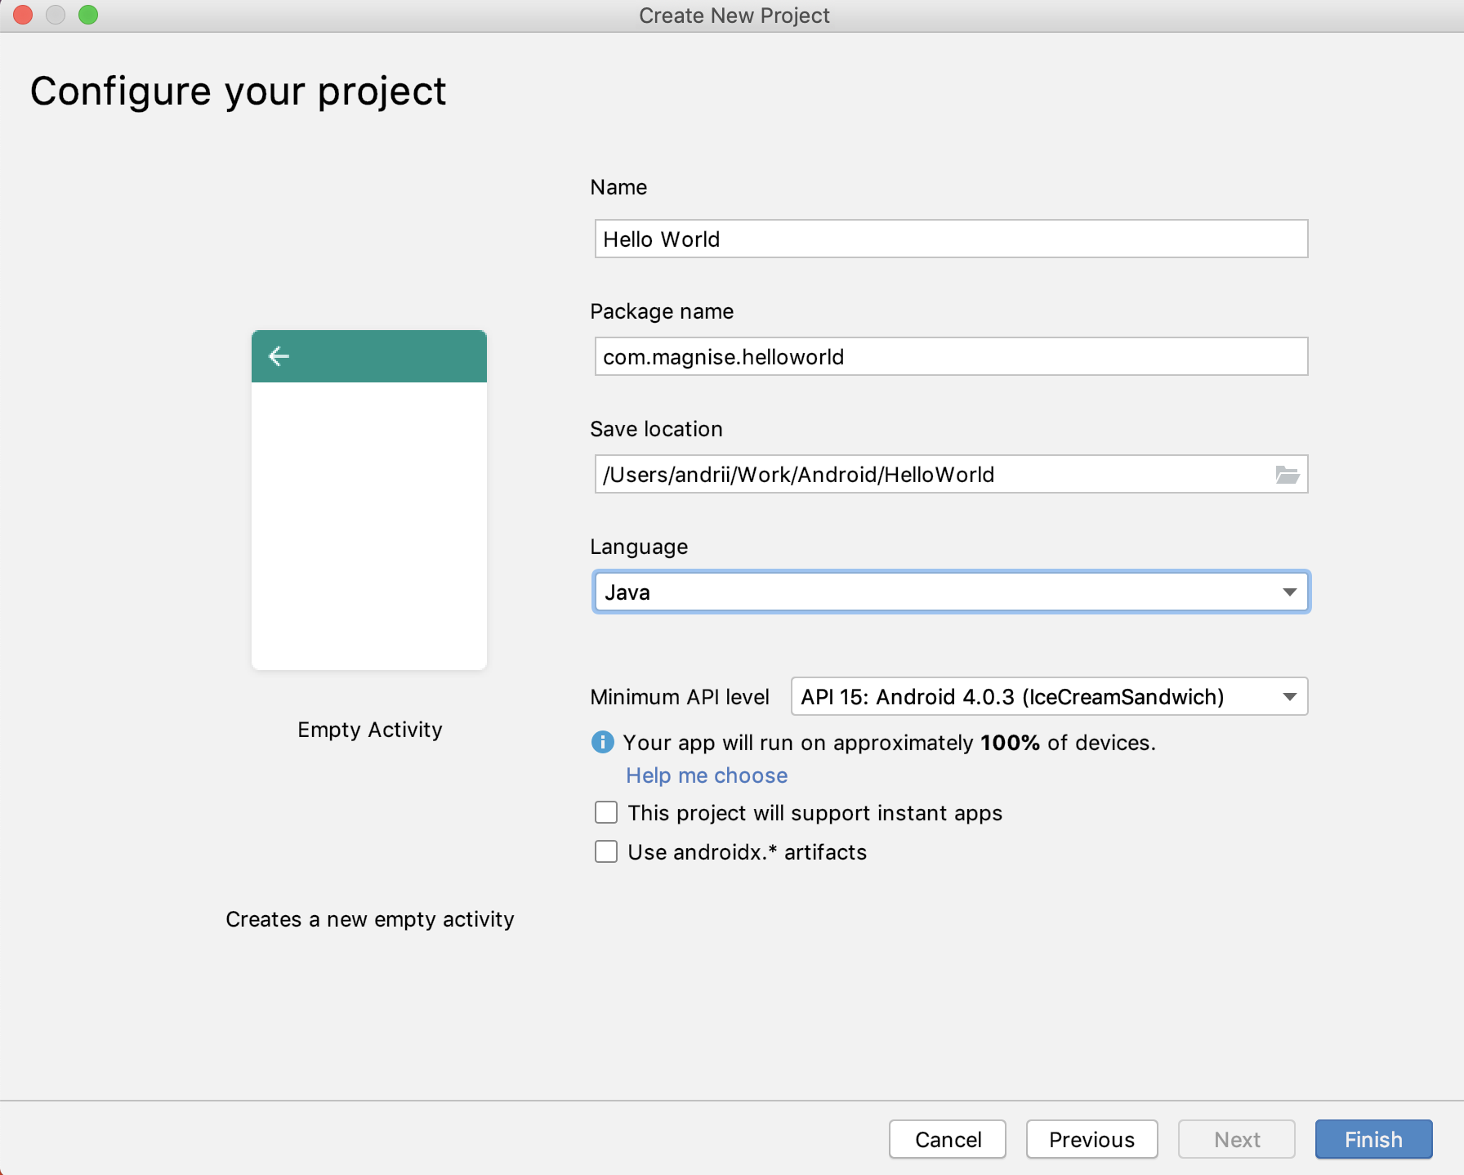
Android Application - Hello World

Slide 6
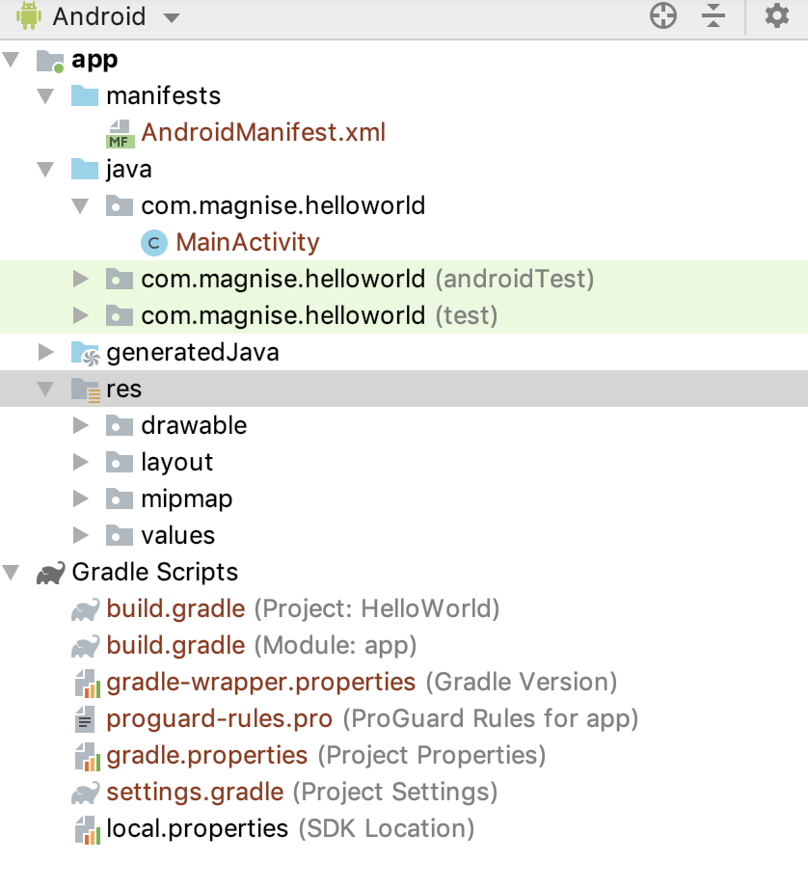
Anatomy of Android Application
Java - contains the .java source files for your project.
res/drawable-hdpi - This is a directory for drawable objects that are designed for high-density screens.
res - directory for files that define your app's user interface.
AndroidManifest.xml - manifest file which describes the fundamental characteristics of the app and defines each of its components.
Build.gradle - auto generated file which contains compileSdkVersion, buildToolsVersion, applicationId, minSdkVersion, targetSdkVersion, versionCode and versionName

Slide 7
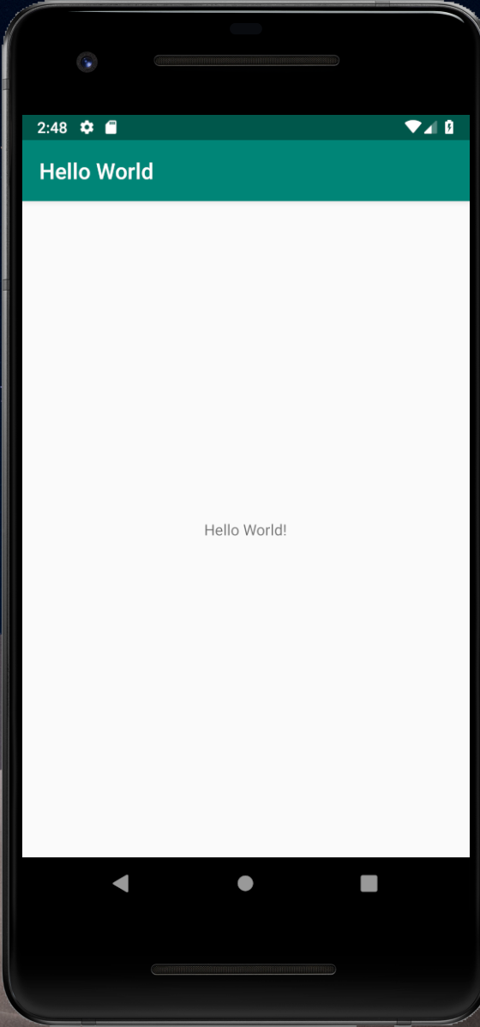
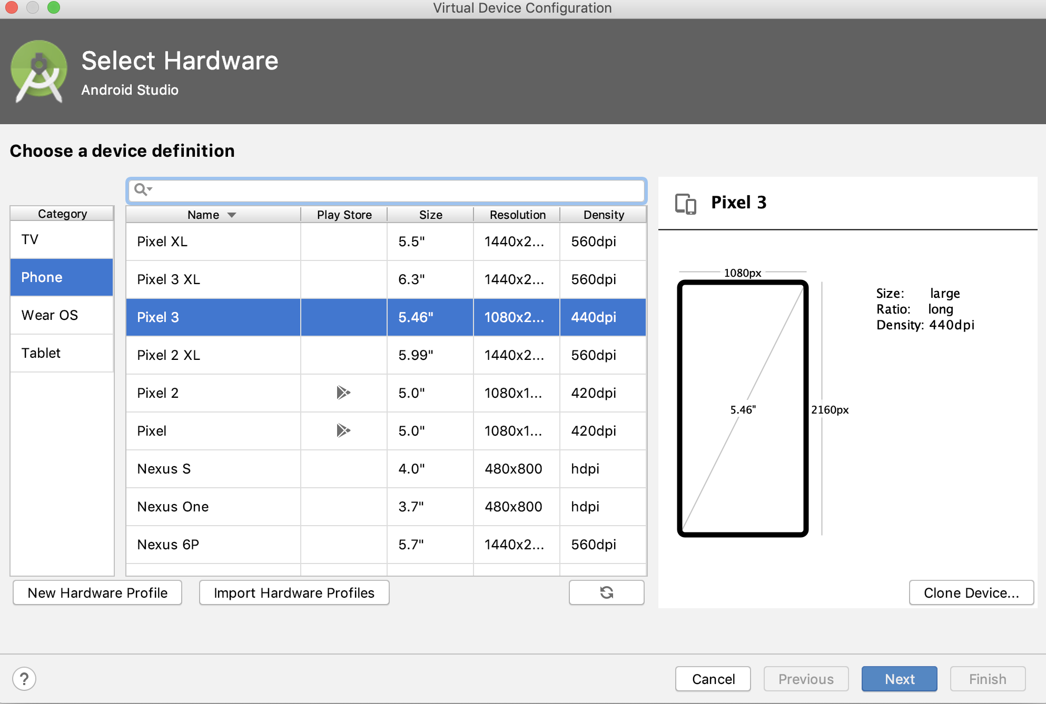
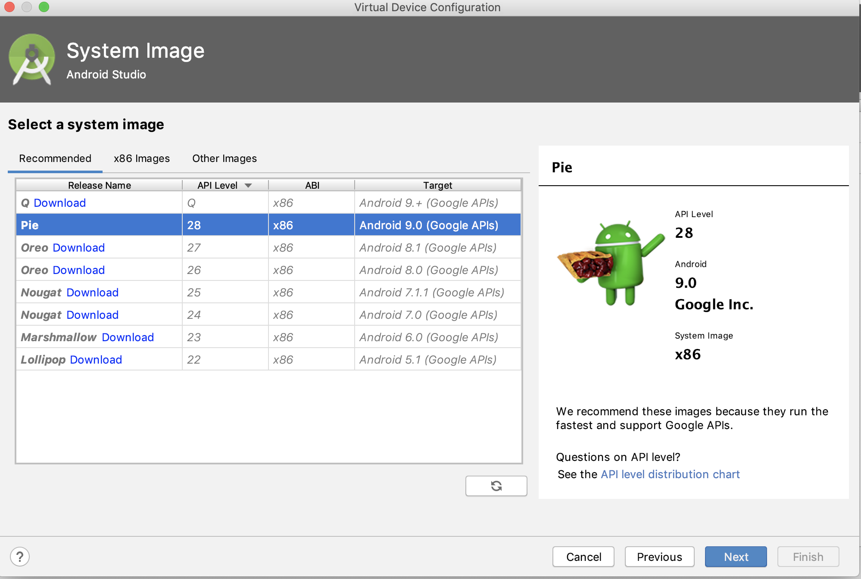
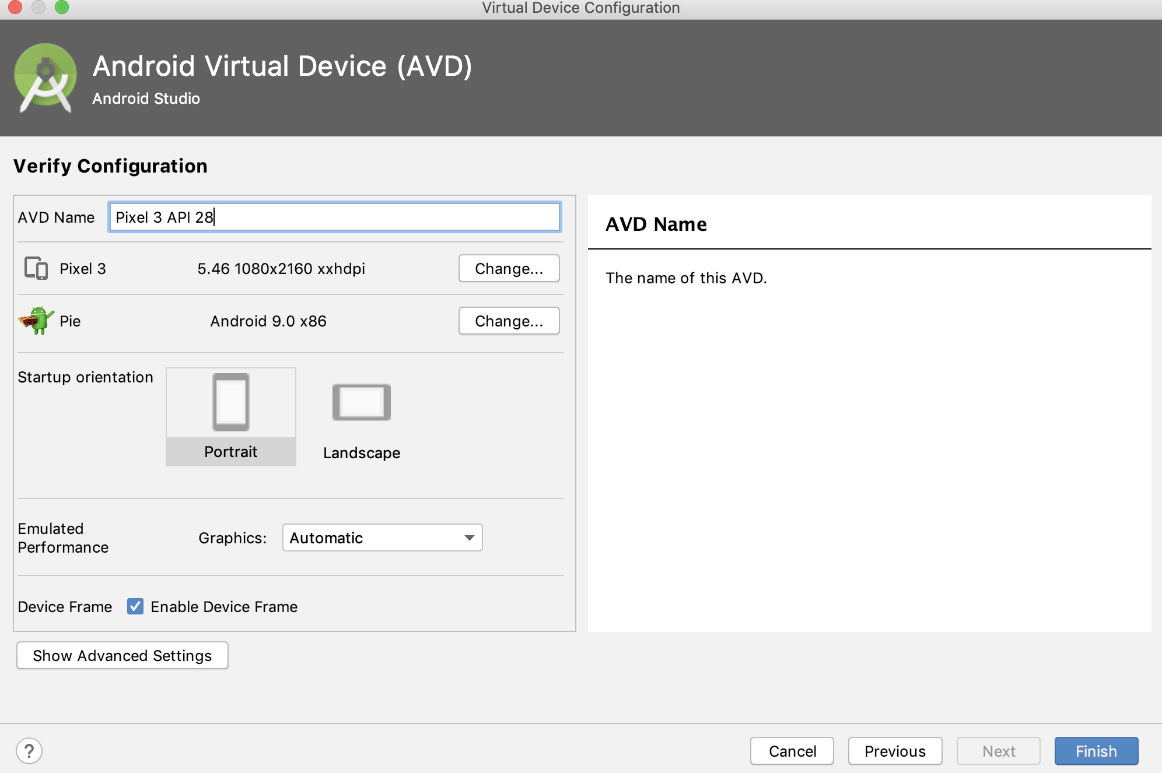
Create a virtual device (AVD)

Slide 8

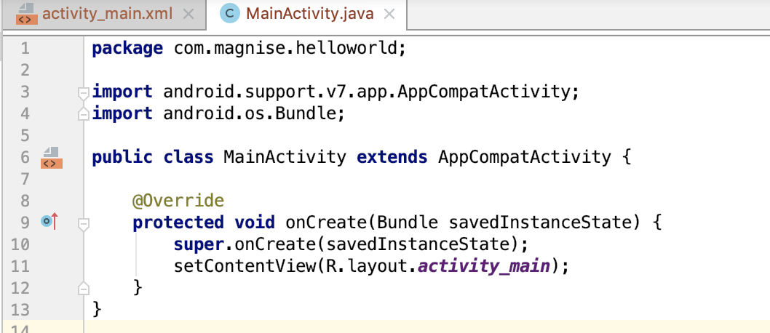
MainActivity
The main activity code is a Java file MainActivity.java. This is the actual application file which ultimately gets converted to a Dalvik executable and runs your application. Following is the default code generated by the application wizard for Hello World! application

Slide 9
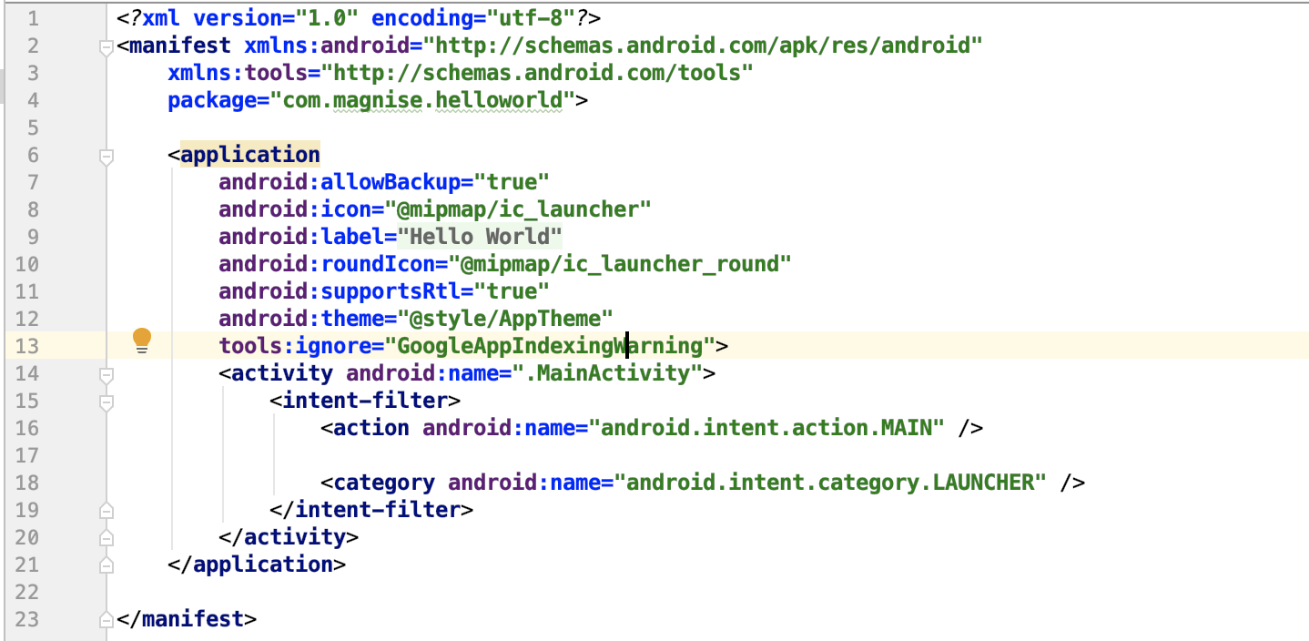
The Manifest File
Manifest file works as an interface between Android OS and your application, so if you do not declare your component in this file, then it will not be considered by the OS

Slide 10
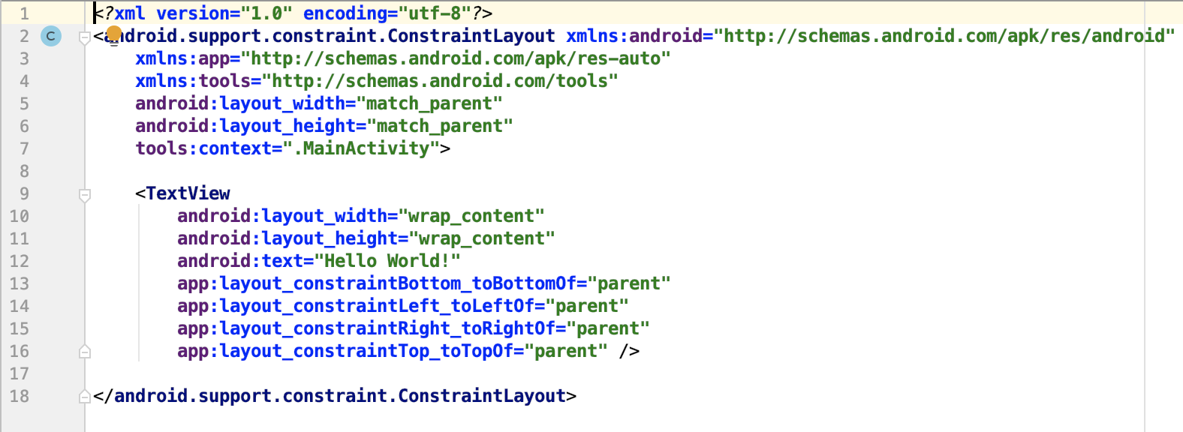
The Layout File

Slide 11
Gradle
Gradle is an open-source build automation system that builds upon the concepts of Apache Ant and Apache Maven and introduces a Groovy-based domain-specific language instead of the XML form used by Apache Maven for declaring the project configuration.

Slide 12

Tracking info about build steps
You can write some custom logging logic for easily understanding of possible issues.
Gradle provides you many configuration features
Configure builds per brand or platform
Your project can have few products, versions or platforms (Android TV, Android Auto)
Signing for bundles/apks
You can prepare some custom signing script and run it for every release build
Distribution configurations
You can write scripts for update version name from git tags, on each release build for example.

Slide 13
Gradle - Configuration scopes
The Gradle have 2 scopes for setting:
Project level:
The top-level build.gradle file, located in the root project directory, defines build configurations that apply to all modules in your project. By default, the top-level build file uses the buildscript block to define the Gradle repositories and dependencies that are common to all modules in the project.
Module level:
The module-level build.gradle file, located in each project/module/ directory, allows you to configure build settings for the specific module it is located in. Configuring these build settings allows you to provide custom packaging options, such as additional build types and product flavors, and override settings in the main/ app manifest or top-level build.gradle file.

Slide 14
Gradle - Project level
buildscript {
ext.kotlin_version = '1.3.31'
repositories {
google()
jcenter()
}
dependencies {
classpath 'com.android.tools.build:gradle:3.4.1'
classpath "org.jetbrains.kotlin:kotlin-gradle-plugin:$kotlin_version"
}
}
allprojects {
repositories {
google()
jcenter()
}
}
task clean(type: Delete) {
delete rootProject.buildDir
}

Slide 15
Gradle - Module level
apply plugin: 'com.android.application'
android {
compileSdkVersion 28
defaultConfig {
minSdkVersion 22
targetSdkVersion 28
versionCode 1
versionName "1.0"
}
buildTypes {
release {
minifyEnabled false
proguardFiles getDefaultProguardFile('proguard-android-optimize.txt'), 'proguard-rules.pro'
}
}
}
dependencies {
implementation fileTree(dir: 'libs', include: ['*.jar'])
testImplementation 'junit:junit:4.12'
implementation 'com.google.android.material:material:1.0.0'
implementation 'androidx.lifecycle:lifecycle-extensions:2.0.0'
}

Slide 16
Gradle - Importing gradle configurations
In projects you will have a lot of gradle configurations, so you should separate it to different modules. You can do it by “apply” keyword at the top of module gradle file.
File “(project)/gradle/kotlin.gradle”:
apply plugin: 'kotlin-android'
apply plugin: 'kotlin-android-extensions'
dependencies {
implementation "org.jetbrains.kotlin:kotlin-stdlib-jdk7:$kotlin_version"
}
Usage: apply plugin: 'com.android.library'
apply from: '../gradle/kotlin.gradle'
android {
...
}
dependencies {
...
}

Slide 17
Gradle - Libraries versioning
Most of projects have imported libraries and many modules. Modules can have same libraries and you should use the same version of library for each module. You can do this with Project Module gradle file.
(Project level) build.gradle:
buildscript {
ext {
kotlin_version = '1.3.31'
}
repositories {
...
}
dependencies {
...
}
}
(Module level) build.gradle:
dependencies {
implementation "org.jetbrains.kotlin:kotlin-stdlib-jdk7:$kotlin_version"
}

Slide 18
Gradle - Implementation vs Api
If you want to use some library in your project - you can include this with 2 keywords: Implementation and Api.
Implementation uses for include libraries without their dependencies.
Api uses for include libraries with their dependencies.

Slide 19
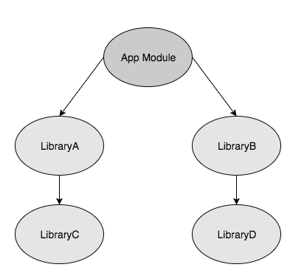
Gradle - Implementation vs Api
For this example you can access the libraryD classes, but can’t access classes from libraryC.
implementation project(path: ':libraryA’)
api project(path: ':libraryB’)

Slide 20

Thank you!

